Slide 1

Software requirements (swr302)
Setting requirement priorities
(chapter 16)

Slide 2
Why prioritize requirements?
Prioritization helps reveal competing goals, resolve conflicts, plan for staged or incremental deliveries, control scope creep, and make the necessary trade-off decisions.
Prioritization is a critical strategy for agile or other projects that develop products through a series of fixed-schedule timeboxes
Establish priorities early in the project, when you have more flexibility for achieving a successful project outcome, and revisit them periodical

Slide 3
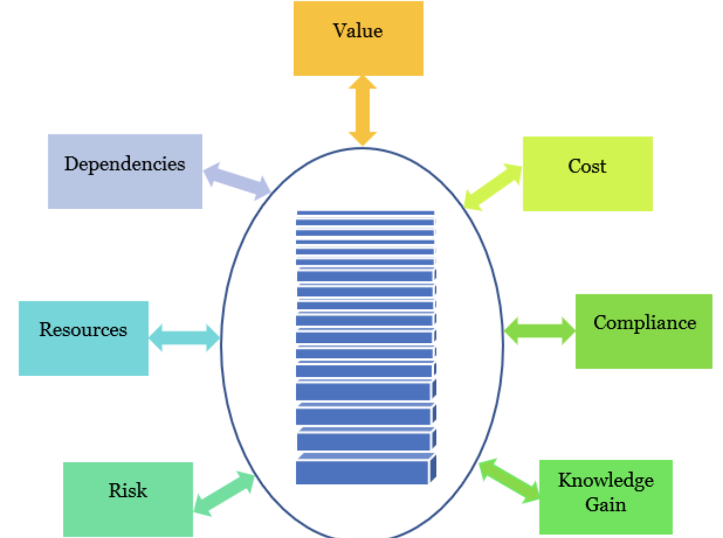
Some prioritization pragmatics
The needs of the customers
The relative importance of requirements to the customers
The timing at which capabilities need to be delivered
Requirements that serve as predecessors for other requirements and other relationships among requirements
Which requirements must be implemented as a group
The cost to satisfy each requirement
Notes:
Pragmatics: ngữ dung học

Slide 4
Games people play with priorities
To encourage customers to acknowledge that some requirements have lower priority, the analyst can ask questions such as the following:
Is there some other way to satisfy the need that this requirement addresses?
What would the consequences be of omitting or deferring this requirement?
What effect would it have on the project’s business objectives if this requirement weren’t implemented for several months?
Why might a customer be unhappy if this requirement were deferred to a later release?
Is having this feature worth delaying release of all of the other features with this same priority?

Slide 5
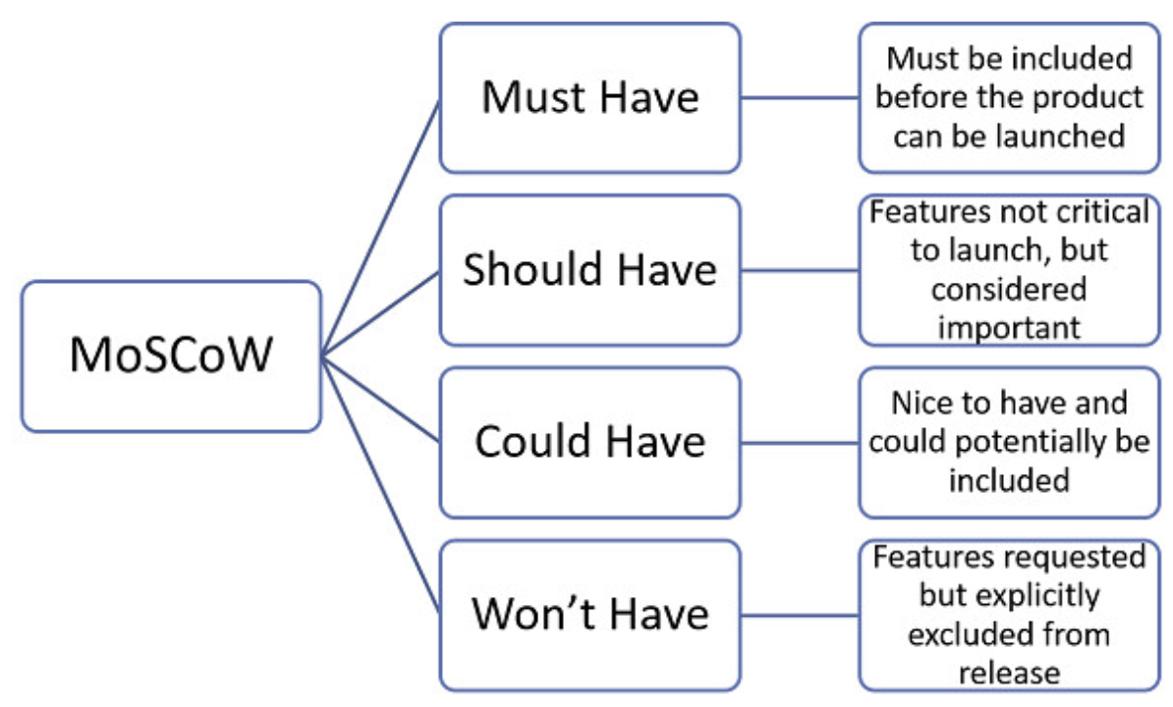
Some prioritization techniques
In or out
Pairwise comparison and rank ordering
Three-level scale
MoSCoW
$100

Slide 6
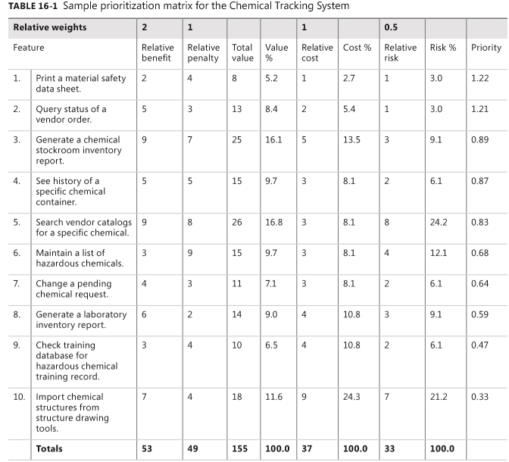
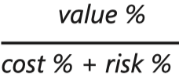
Prioritization based on value, cost, and risk
Total value =
2*benefit + penalty
Priority =

Slide 7


